Slide 1
Predicting Improvement of Neighborhoods
Finding Better Place to Open a Restaurant
Prepare By:
Rajib Mukhopadhyay

Slide 2
Introduction
Delhi and Kolkata are two major cities in India. These two cities become a centre of attention for residential, job employment, tourism, education, shopping and sports activity. Both cities are well known in India and all over the world, and become the top choice for local and foreign communities.

Slide 3
Business Problem
Some of the features need to focus which may causes the business problem
Restaurant Style
Type of food.
Service to provide.
Open or close area.
Target Market
Competitors
Prepare Menu
Location and Premises

Slide 4
Data - Acquisition and Cleaning
Acquisition
List of boroughs and neighborhoods of the two cities:
https://www.mapsofindia.com/pincode/india/delhi/
https://www.mapsofindia.com/pincode/india/west-bengal/kolkata/
List of the two cities (latitude and longitude)
using geopy.geocoders library
List of restaurants and shops with their address location.
Foursquare (www.Foursquare.com) and geopy data to map top venues for Delhi and Kolkata neighborhoods and clustered in groups.
Cleaning
Missing values need to clean with a default or some common average value.

Slide 5
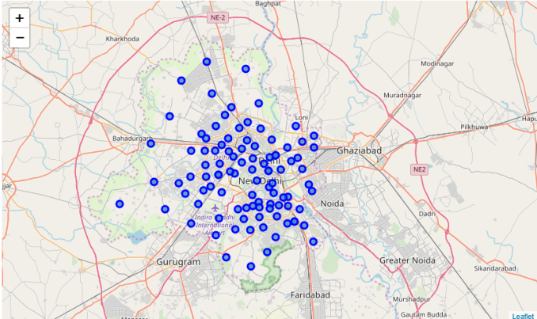
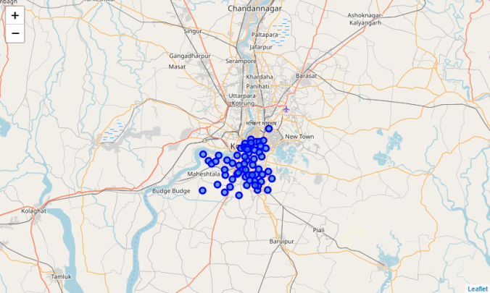
Relationship
Make a relationship about the neighborhoods of both the cities and try to find out the venues and hot spot in that areas.
Delhi
Kolkata

Slide 6
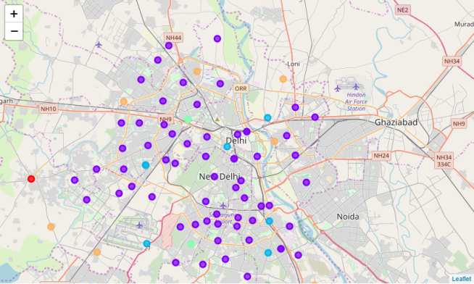
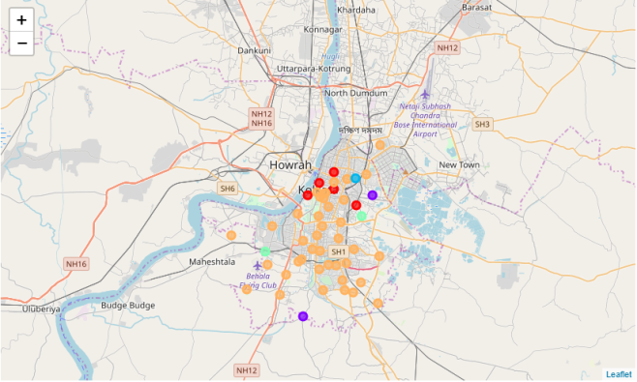
K-means Clustering Algorithm
Visualize the neighborhoods in Delhi and Kolkata and their emerging clusters.
Delhi
Kolkata

Slide 7
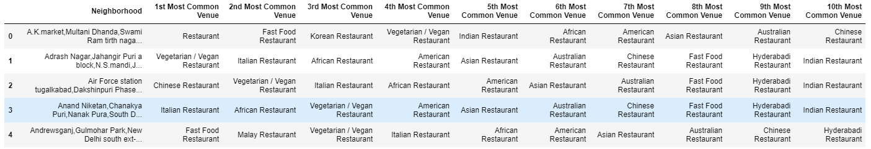
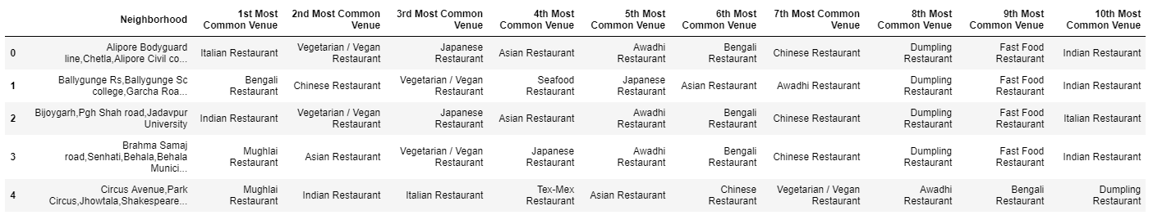
Result

Slide 8
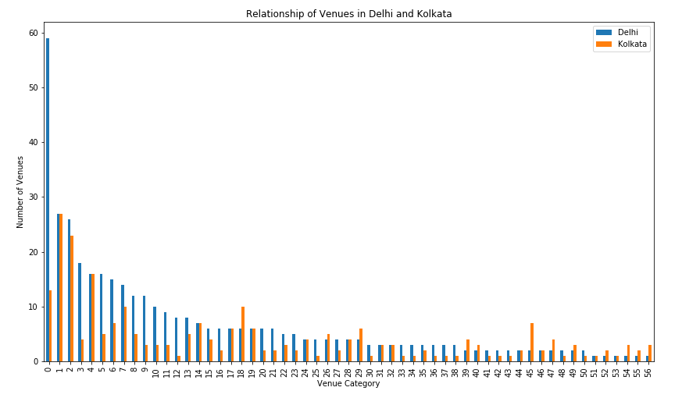
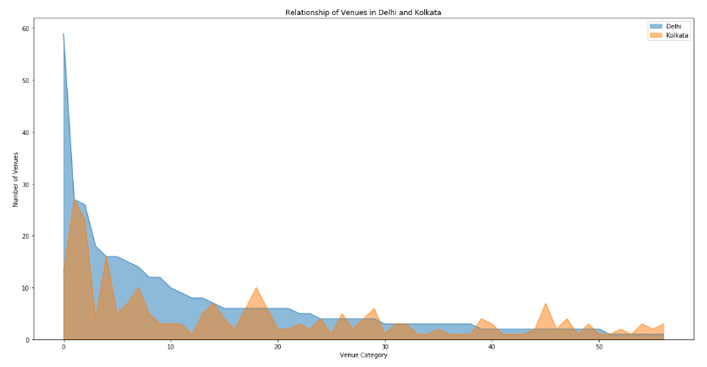
Result

Slide 9
Discussion
By this project I assumed by analysing each cluster:
Delhi is having more demand on
Indian Restaurant,
Mughlai Restaurant.
Kolkata is having demand on
Chinese Restaurant,
Fast Food Restaurant.

Slide 10
Conclusions
In this study, I analysed the venues between Kolkata and Delhi, the major two cities in India.
I identified both cities are similar in some venues also dissimilar in certain venues and for classification based on common venues, again we must have more systematic or quantitative way to identify and declare this.
Comparison can be made, but no such method or quantitative data to determine this.
We hope in the future, a method to determine it can be establish and explore for references.
Thank you

